Slide 1
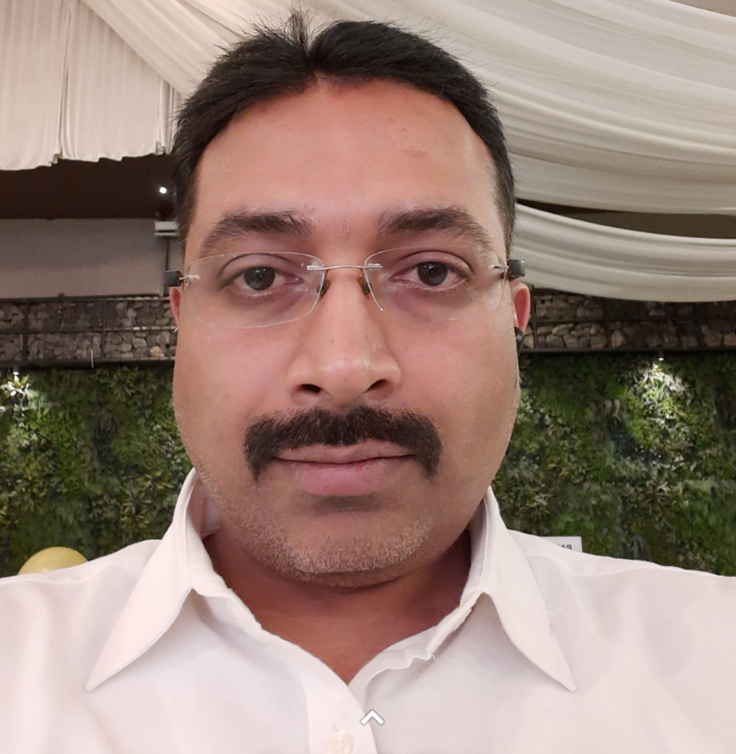



Professional Summary
Vivek Pradeep Kadam
Functional Testing
Test Lead
Project Management Support & Coordination
Test Management
Automation Testing: Playwright & Cypress
Education:
Bachelor of Engineering in Computers
Diploma in Computer Technology
Certifications:
Technical Skills:
Soft Skills:
Contact Information:
Vivek.Kadam@cognizant.com
+91 – 9850220482
Pune, India
18 years of experience in Software Testing & Quality Assurance using Agile methodology.
Core expertise in Functional Testing at Integration, System, and User Acceptance Testing (UAT) levels to validate product/software functionality based on SRS, FRS & BRD.
Core expertise in gathering requirements, creating test plans, test estimations, developing test strategies, scheduling, resource planning, writing/review test scenarios and cases, maintaining a traceability matrix, preparing/maintaining test data, and producing testing progress and completion reports.
Expertise and experience in Defect & Incident Management with a decentralized, geographically distributed team of business users and project staff.
Experience in risk management, client communication, stakeholder liaising, and managing resource productivity
Active member of Quality Assurance CoE team focused on developing, standardizing, and promoting testing best practices, methodologies, and tools within team/organization; e.g. Root Cause Analysis.
Projects Experience
Merck KGaA, Germany (Project Management Support and Coordination) – Content Management Systems based on Adobe Experience Manager (AEM) that involved migration from old code base to new code base for 210+ websites.
Novo Nordisk Inc. USA (Test Lead) – Migration of AEM On-Prem to Cloud via Adobe AEM as Cloud Service. Handled a team of 18+ QA members involved in testing for AEM customized and OTS component used by developers and marketers to organize and distribute content across digital channels.
Boehringer Ingelheim, Germany (Test Lead) – Migration from legacy to Veeva Systems in Data Migration, Interface and Process Config areas with GxP practices of Life Science industry. Handled team of 10+ QA members working in Veeva Vault QMS with below responsibilities in line with GxP practices of Life Science industry.
Credit Suisse Group AG (Test Analyst) - APAC Exchange connectivity team responsible for Order Routing, Exchange Link and Dark Pool (Internal Order Crossing Engine) & Smart Order Routing Systems.
Barclays Capital Inc. (Test Analyst) - Securities Lending, Collateral Allocation and Client Asset Utilization team.
Functional Testing
Automation Testing
Playwright - JS/TS
Cypress - JS
JIRA
HP - ALM
Azure DevOps
Adobe Exp. Manager
SQL
Work Experience
Project Management
Leadership
Cognizant Technology Solutions, India Pvt. Ltd.
Senior associate
(Nov. 2011 - Present)
Collaboration
Problem Solving
ATOS INDIA PVT. LTd.
Test analyst
(Mar. 2008 – Oct. 2011)
Support & Co-ordination
Execution
Conflict Resolution
Negotiating
Virstra i-technology services ltd. (IBU of Nucleus Software Exports ltd.)
Test engineer
(Aug. 2006 – Mar. 2011)

